Slide 1

SHRI SAI SHIKSHAN SANSTHA’S NAGPUR INSTITUTE OF TECHNOLOGY, NAGPUR Department of Information Technology 2024-2025
Title: PETS-KART -a comprehensive and user-friendly online platform that revolutionises the way people interact with pets and animals.
Project Members | Guided by
 | Prof. R. R. Kadam Assistant Professor Information Technology Department Co- Guide by Prof. R. R. Kadam Assistant Professor Information Technology Department
1) Yash Jogi
2) Khushi Gupta
3) Krotick Dahatkar
4) Kamakshi Samarth
Session 2024-25
@NIT,Nagpur

Slide 2
CONTENT
Introduction
Objectives
Literature Review
Problem Statement
Methodology
Outcomes/ Results
Conclusion
Future Scope
References
Copyrights, Paper Publication, Project and Poster Competition (Photos with Certificates)
NIT,Nagpur

Slide 3
Introduction
In today's digital age, the way we approach pet ownership and animal care has evolved significantly. The growing demand for convenient and reliable platforms to buy, adopt, and sell pets and domestic animals has led to the creation of dedicated websites. This report explores the development and impact of a comprehensive website designed to facilitate the proper buying, adopting, and selling of pets and domestic animals.
Beyond transactions, the platform also offers a range of solutions addressing the diverse needs of animal owners, ensuring responsible pet ownership, and enhancing the welfare of animals.
Through this website, we aim to connect animal lovers with the resources they need to make informed decisions, promoting the health and happiness of both pets and their owners.
NIT,Nagpur

Slide 4
Objective
All-in-One Platform – Buy, sell, and adopt pets, livestock, and essentials in one place.
Seamless Transactions – Ensure secure buying, selling, and adoption with verified listings.
Adoption & Rescue Support – Partner with shelters to promote pet adoption.
Veterinary Services – Offer online vet consultations and health check-ups.
Animal Essentials Store – Provide food, accessories, medicines, and livestock supplies.
Community Engagement – Enable discussions, expert advice, and pet care tips.
Future Expansion – Plan for mobile apps, doorstep delivery, pet insurance, and training.
NIT,Nagpur

Slide 5
Literature Review
1. Digital Pet Product & Service Platforms: The Diversity of the Industry
January 2022 DOI:10.2991/aebmr.k.220307.466LicenseCC BY-NC Conference: 2022 7th International Conference on Financial Innovation and Economic Development (ICFIED 2022)
2.Reflect on the Past 45 Years of the Pet Industry
Jan 2016 Glenn PolynGlenn Polyn. (2016) Reflect on the Past 45 Years of the Pet Industry. https://www.petage.com/45-yearsand-counting/
3.Research Report on the Innovation and Development of China's Pet Economy
Jan 2020 Jianhao Liu. (2020) Research Report on the Innovation and Development of China's Pet Economy. https://www.iyiou.com/research/20201013753
4.Rover Investor Call Presentation
Jan 2021 Rover Rover. (2021) Rover Investor Call Presentation. https://www.rover.com/blog/wpcontent/uploads/2021/02/Rover_Investor_Call_Pre sentation.pdf
NIT,Nagpur

Slide 6
Literature Review
5. Jan 2019 Cascadia Capital (2019) Pet Industry Overview. http://www.cascadiacapital.com/wpcontent/uploads/2019/10/Cascadia-Capital-Pet-Industry-Report-Spring-2019-vF.pdf
6.Determinants of pet food purchasing decisions
Jan 2019Molly Schleicher ,B Seam ,Lisa M Cash ,Freeman Molly Schleicher, Seam B Cash, Lisa M Freeman. (2019) Determinants of pet food purchasing decisions. https://pubmed.ncbi.nlm.nih.gov/31156266/
7.Bark Management Presentation
Jan 2020 Barkbox BarkBox. (2020) Bark Management Presentation. https://static1.squarespace.com/static/5fc91530343 6806905d7150e/t/5fdae20279e44d2bcf557f77/160 8180228067/BARK-Overview-12162020.pdf
8. The Chewy Business Model -How Does Chewy Make Money
Jan 2021 Viktor. (2021) The Chewy Business Model -How Does Chewy Make Money?. https://productmint.com/chewy-business-modelhow-does-chewy-make-money/
NIT,Nagpur

Slide 7
Problem Statement
Lack of a Unified Platform – Users must visit multiple websites for buying, selling, and adopting pets and livestock.
Inconvenient Transactions – No single platform ensures secure and verified animal transactions.
Limited Access to Veterinary Services – Users struggle to find reliable online vet consultations and healthcare support.
Scattered Availability of Essentials – Pet food, accessories, medicines, and livestock supplies are not easily accessible in one place.
Trust & Verification Issues – Lack of proper authentication leads to fraudulent listings and unethical animal trading.
Inefficient User Experience – Switching between platforms for different needs creates inconvenience and time wastage.
Need for Community & Guidance – Pet owners and farmers lack a dedicated space for discussions, expert advice, and care tips
NIT,Nagpur

Slide 8
Methodology
Needs Assessment: Identify user pain points through market research and interviews.
Design & Wireframing: Create an intuitive and visually appealing interface.
Development: Build a responsive platform using modern frameworks .
Content Creation: Provide educational resources on livestock care, breeding, and market trends.
Database Management: Design a secure database for users, listings, and services.
Testing & QA: Ensure functionality, usability, and bug-free performance.
NIT,Nagpur

Slide 9
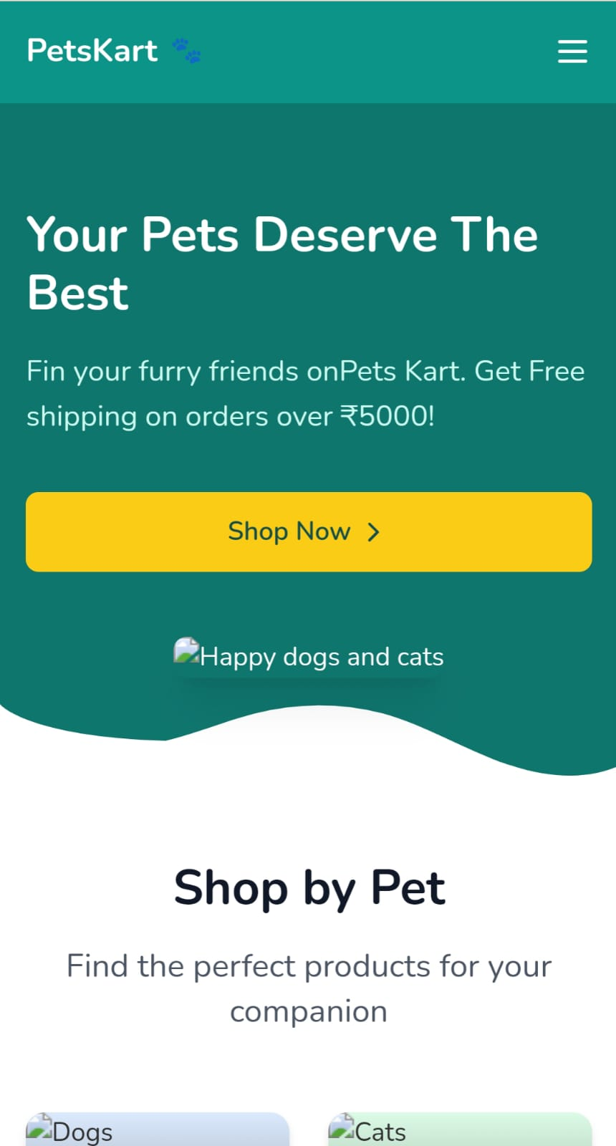
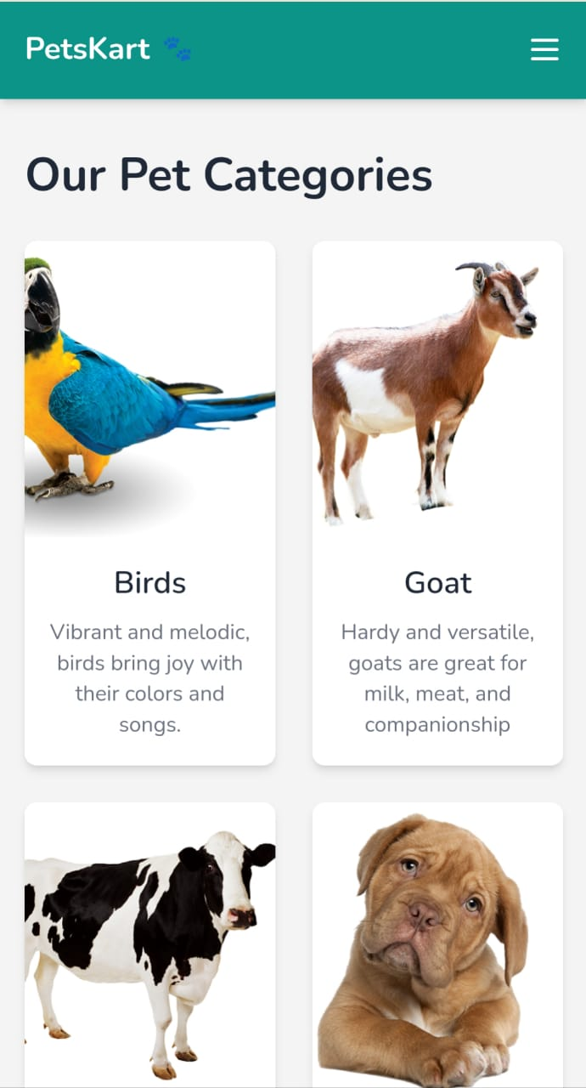
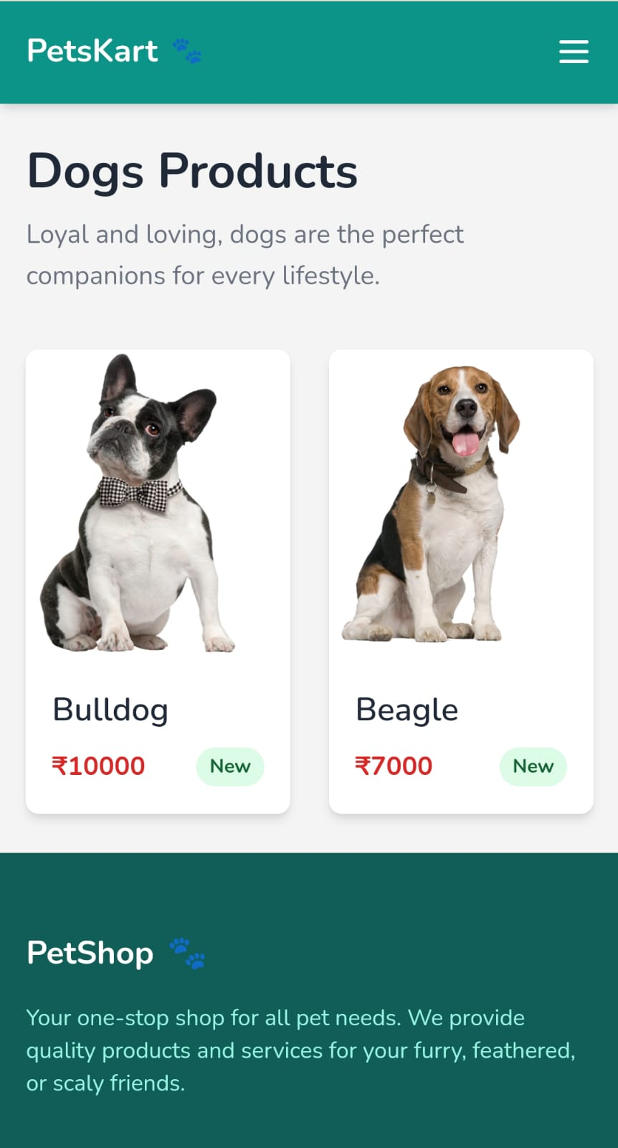
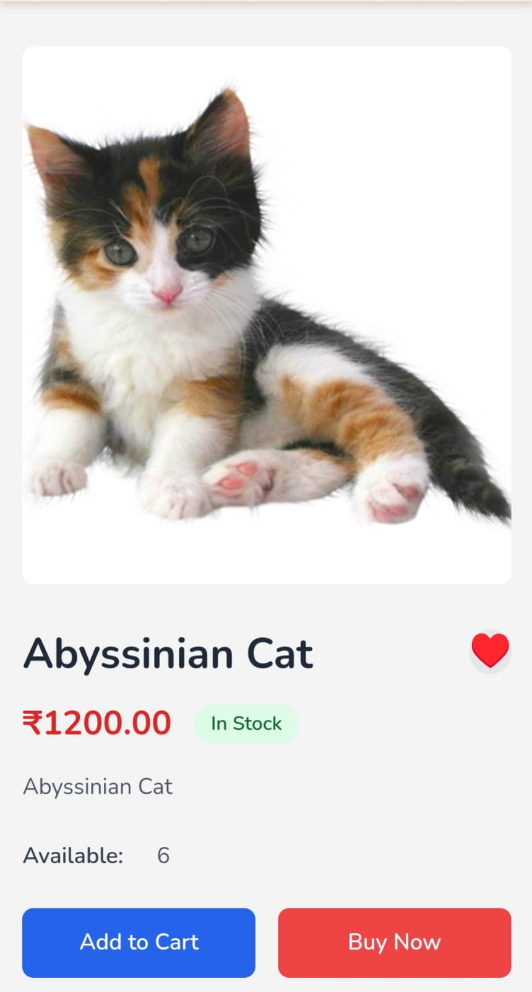
Outcomes / Results
NIT,Nagpur

Slide 10
Conclusion
A comprehensive e-commerce platform for buying, selling, and adopting pets and livestock, along with essential products and services, will eliminate the need for multiple websites and provide a seamless, secure, and trustworthy experience. This platform will revolutionise the pet and livestock industry by integrating vet consultations, verified transactions, and a wide range of animal essentials.
Additionally, with future expansions like doorstep delivery, insurance, and training programs, it will serve as a one-stop solution for all animal-related needs, ensuring convenience, efficiency, and animal welfare.
NIT,Nagpur

Slide 11
Future Scope
Veterinary Services:
Partner with local veterinarians to offer online consultations and discounted services.
Provide information on pet health, care, and nutrition.
Pet Training Resources:
Offer online training resources, such as articles, videos, and courses.
Connect users with professional dog trainers and behaviorists.
Pet Insurance:
Partner with insurance providers to offer affordable pet insurance options.
Pet Products and Supplies:
Provide a marketplace for pet products and supplies, including food, toys, accessories, and grooming products.
Livestock Resources:
Offer information on livestock care, breeding, and management.
Connect livestock owners with experts and service providers.
NIT,Nagpur

Slide 12
References
[1]Glenn Polyn. (2016) Reflect on the Past 45 Years of the Pet Industry. https://www.petage.com/45-yearsand-counting/
[2] Jianhao Liu. (2020) Research Report on the Innovation and Development of China's Pet Economy. https://www.iyiou.com/research/20201013753
[3] Reilly Roberts. (2021) Pet Industry Trends, Growth & Statistics in 2021 and Beyond: Unleashing Your Ecommerce Pet Marketing Strategies. https://commonthreadco.com/blogs/coachscorner/pet-industry-trends-growth-ecommercemarketing
[4] Cascadia Capital. (2019) Pet Industry Overview. http://www.cascadiacapital.com/wpcontent/uploads/2019/10/Cascadia-Capital-PetIndustry-Report-Spring-2019-vF.pdf
[5] Josh Howarth.(2021) 7 Pet Industry Trends To Know (2021-2025). https://explodingtopics.com/blog/pet-industrytrends
NIT,Nagpur

Slide 13
References
[6] American Pet Products Association.(2021) Pet Industry Market Size, trends & Ownership Statistics.https://www.americanpetproducts.org/pre ss_industrytrends.asp
[7] Molly Schleicher, Seam B Cash, Lisa M Freeman. (2019) Determinants of pet food purchasing decisions. https://pubmed.ncbi.nlm.nih.gov/31156266/
[8] Rover. (2021) Rover Investor Call Presentation. https://www.rover.com/blog/wpcontent/uploads/2021/02/Rover_Investor_Call_Pre sentation.pdf
[9] BarkBox. (2020) Bark Management Presentation. https://static1.squarespace.com/static/5fc91530343 6806905d7150e/t/5fdae20279e44d2bcf557f77/160 8180228067/BARK-Overview-12162020.pdf
[10] Viktor. (2021) The Chewy Business Model – How Does Chewy Make Money?. https://productmint.com/chewy-business-modelhow-does-chewy-make-money/
NIT,Nagpur

Slide 14
Copyright
In Process……
NIT,Nagpur

Slide 15
Project and Poster Competition (Photos with Certificates)
Name of college attended Competition | Name of competition | Date | Prize( If any)
Nagpur Institute Of Technology | GEN Z IDEA GENESIS 2024 | 15-APRIL-2024 | NA
NIT,Nagpur

Slide 16
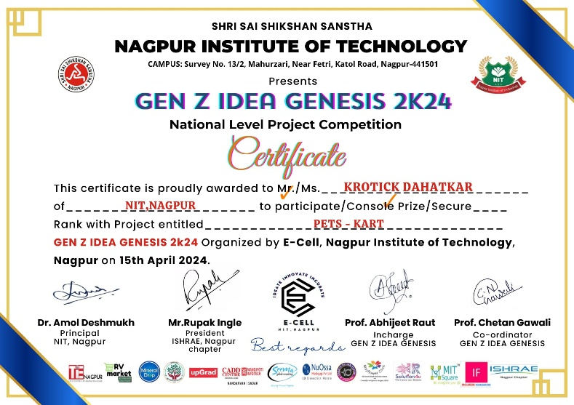


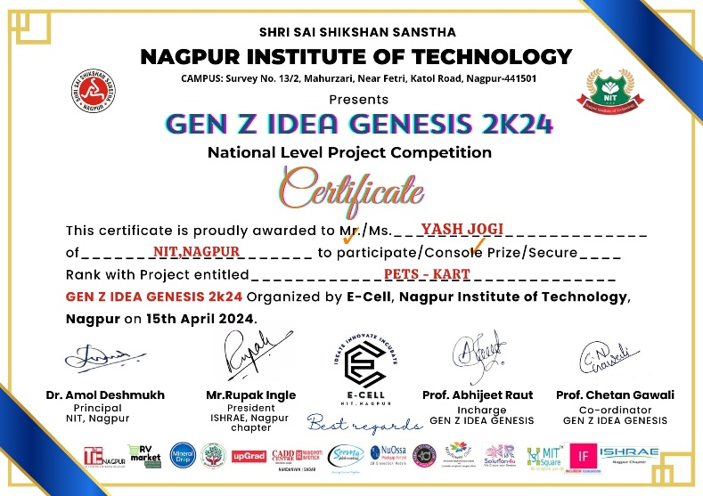
Project and Poster Competition (Photos with Certificates)
NIT,Nagpur

Slide 17
Journal and Conference Paper Details with Certificate
Paper Title | Name of Conference | Date of conference
In Process……
Paper Title | Name of journal | ISSN no
NIT,Nagpur

